Slide 1
GenAI Orchestrator for Email and Triage/Routing
Team Sigma AI Coders

Slide 2
Problem Statement
Develop a Gen Al-powered Email Classification and OCR solution that can:
1. Accurately extract, interpret the context and categorizes emails in to predefined request types and sub request types based on the sender's intent along with reasoning.
2. Context based data extraction: Extract configurable fields like deal name, amount, expiration date etc. from both email bodies and attachments varying based on the request type.
3. Handling multi request email with primary intent detection: The solution should be able to support complex cases where single email can contain multiple request types ensuring each is identified based on sender's ask. Also determine the primary request which represent sender's main intent even when the email discuss multiple topics
4. Priority based Extraction: Implemented customizable extraction rules such as prioritizing emails content over documents for request type identification while extracting numerical fields from attachments
5. Duplicate Email Detection: Identify duplicate emails that may arise due to multiple replies or forward within an email thread. This reduces operational risk and prevents redundant service requests.

Slide 3
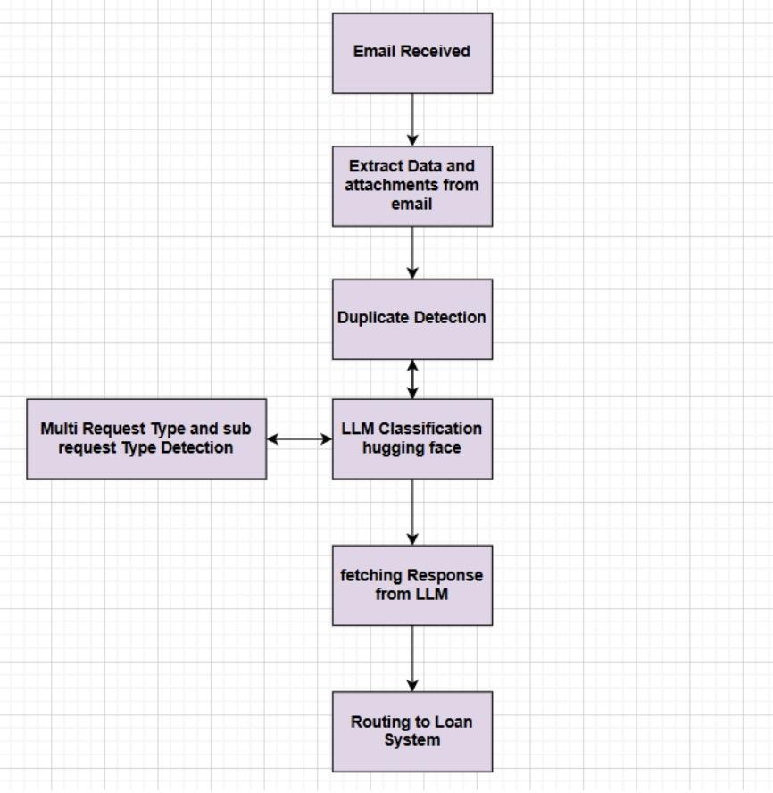
Architectural Diagram

Slide 4
Implementation Details
Backend: Flask (Python) – API for processing email files.
AI Model: Hugging Face's Mistral-7B-Instruct-v0.3 for text classification.
Embeddings & Similarity Search: FAISS (Facebook AI Similarity Search) to detect duplicate emails.
OCR & Text Extraction: pdfplumber for extracting text from PDFs. python-docx for DOCX processing. pytesseract for OCR-based extraction.
Prompt Engineering: LangChain to generate structured prompts for classification.

Slide 5
Team Members
Rahul Srivastava
Viral Ashwin Bundella
Shaik S Saheb
Nalini R
Dhirav Choudhary

Slide 6
Thank You

